Slide 1
WinUI - Getting started
https://learn.microsoft.com/en-us/windows/apps/get-started

Slide 2
What is WinUI?
XAML markup-based user interface layer
Contains modern controls and styles for building Windows apps
Native UI layer for Windows App SDK
Embodies Fluent Design

Slide 3
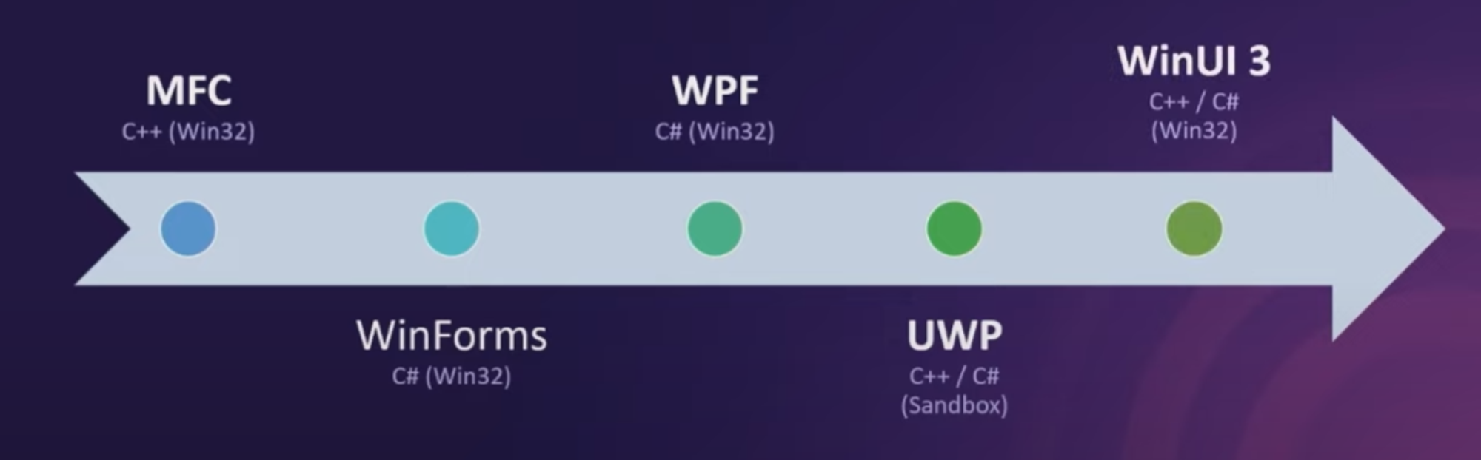
History

Slide 4
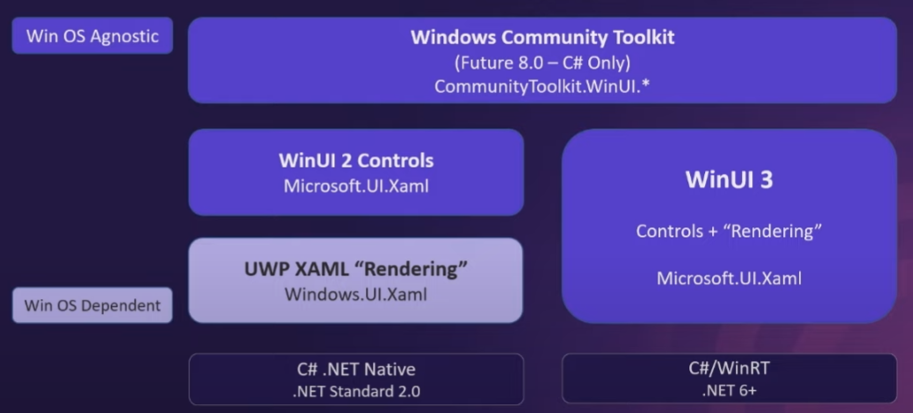
Evolution

Slide 5

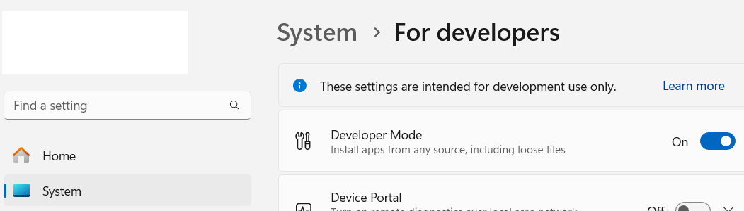
Getting started
Install Visual Studio (Community Edition is enough)
Required workload:
2. Enable Developer Mode

Slide 6
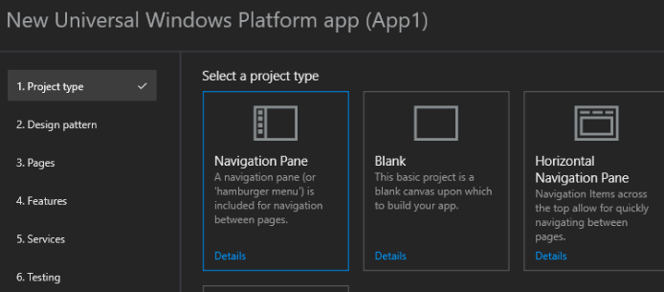
3. Extension: Template Studio for WinUI
Create apps using C# and the MVVM Toolkit
Must use the MVVM design pattern
Support multiple layout

Slide 7
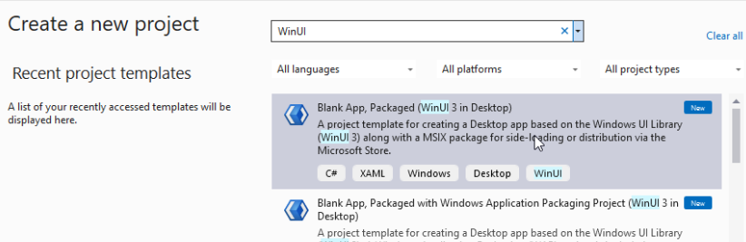
Create your first WinUI app

Slide 8

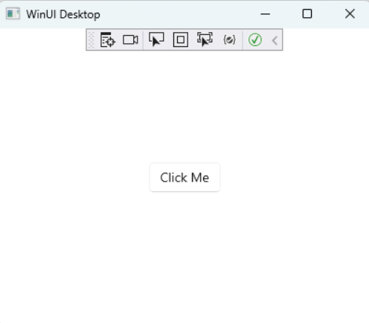
Build & Launch the app: Ctrl + Shift + B > Ctrl + F5

Slide 9
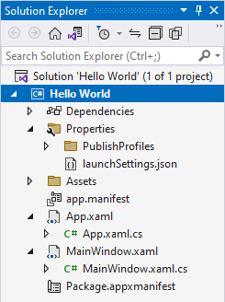
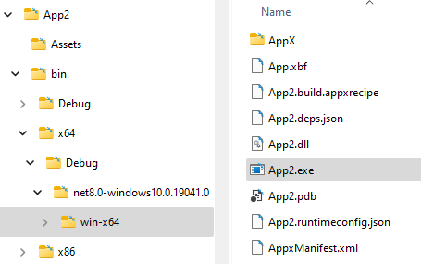
Project structure & Artifacts
Currently you cannot run this exe file directly!
You must deploy it!

Slide 10
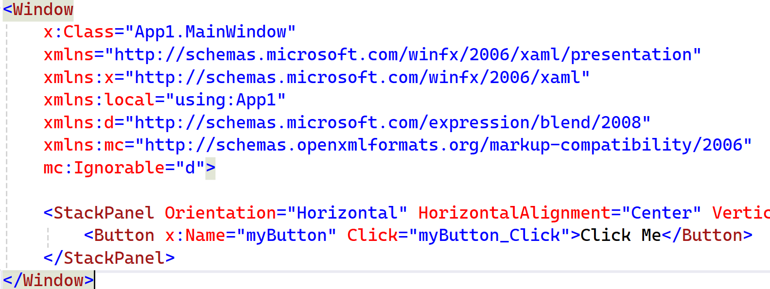
UI definition: MainWindow.xaml

Slide 11
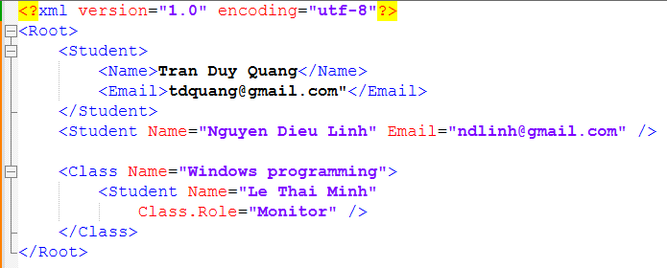
XML Quick summary

Slide 12
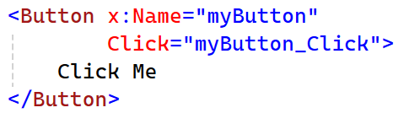
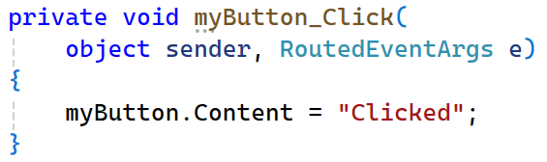
Event handler mapping: MainWindow.xaml.cs

Slide 13
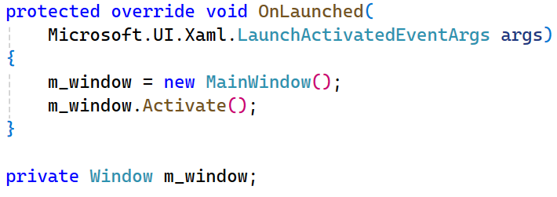
Entry point: App.xaml.cs > OnLaunched

Slide 14
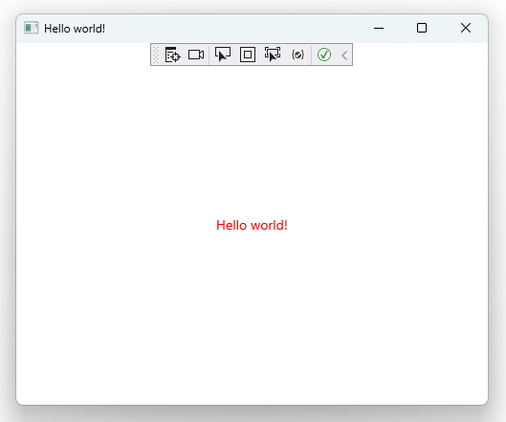
Minor changes
Create a red “Hello world” text instead of a button
Change the Title to “Hello world”

Slide 15
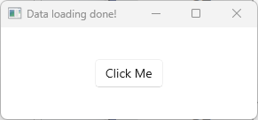
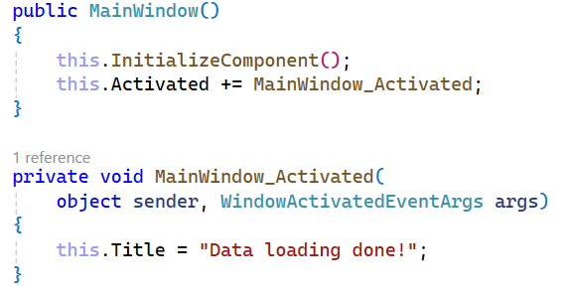
Another change

Slide 16
Clean for submission
Build > Clean solution
Delete these folders: .vs, bin, obj
Your compressed file should be very small!

Slide 17
Local Publish & Deploy
Packaging MSIX apps - MSIX | Microsoft Learn

Slide 18
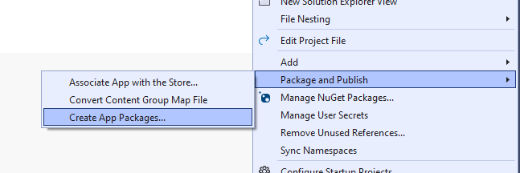
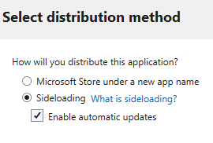
Create msix file by creating a package

Slide 19
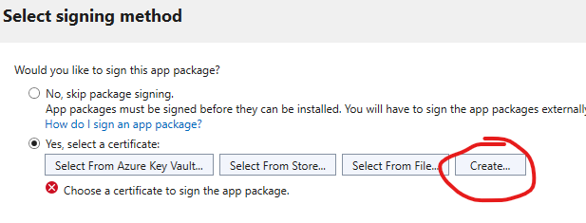
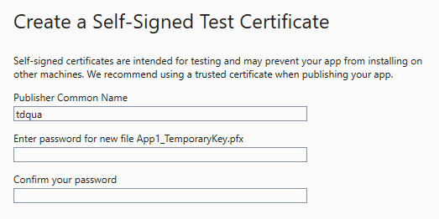
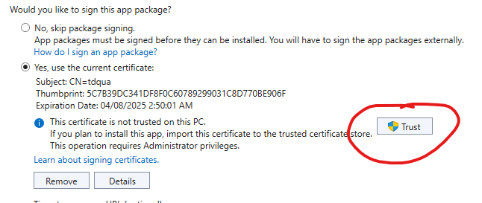
2. Sign your package & Trust it

Slide 20
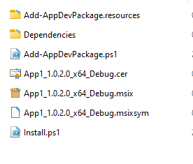
Install using the newly created msix file
On other machine, install certificate first!!!! (file .cer)

Slide 21
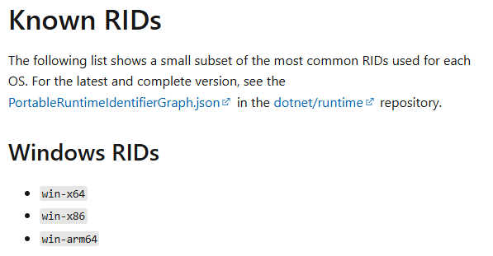
Template Studio - Fixing RuntimeIdentifier error
Right click Project > Edit project file, delete the line that contains “win10-x86;win10-x64;win10-arm64”

Slide 22
Samples & Resources

Slide 23
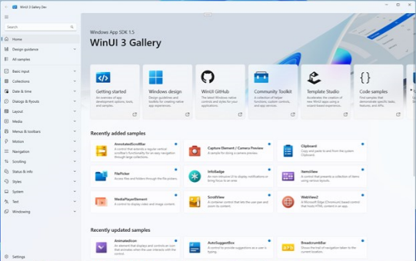
Store > WinUI 3 gallery
Get an idea of what WinUI has to offer
Source: https://github.com/microsoft/WinUI-Gallery

Slide 24
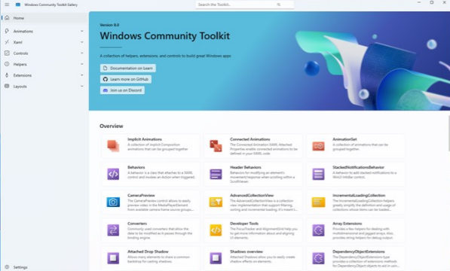
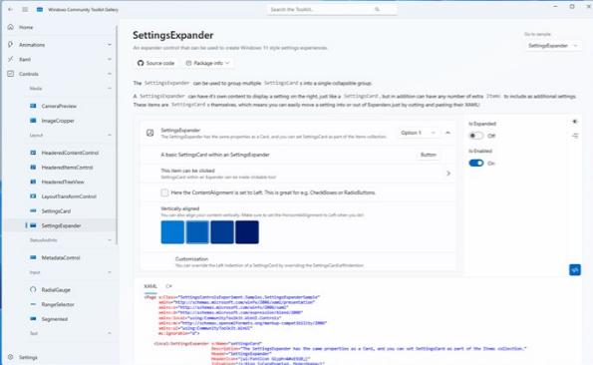
Store > Windows Community Toolkit Gallery
Collection of helper functions, custom controls, app services
Simplifies and demonstrates common developer tasks
Source: https://github.com/CommunityToolkit/Windows
Web version: https://toolkitlabs.dev

Slide 25
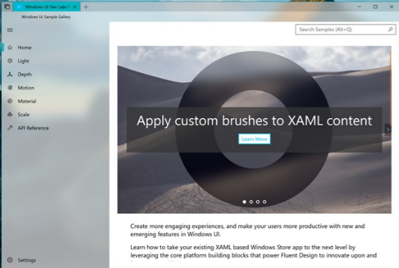
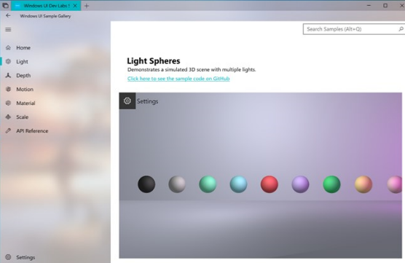
Store > Windows Composition Samples
How to customize your app
Source: https://github.com/microsoft/WindowsCompositionSamples

Slide 26
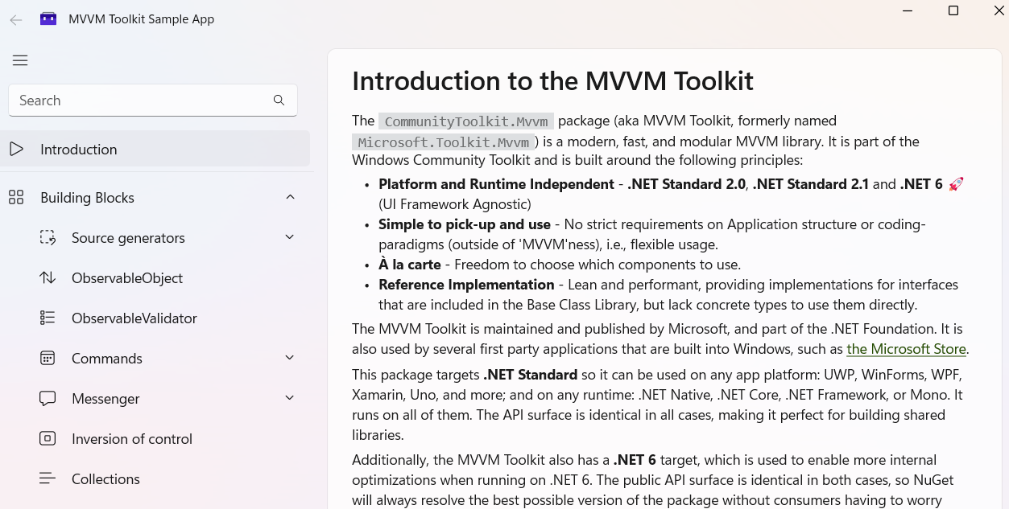
MVVM Toolkit & Samples
CommunityToolkit/MVVM-Samples: Sample repo for MVVM package

Slide 27
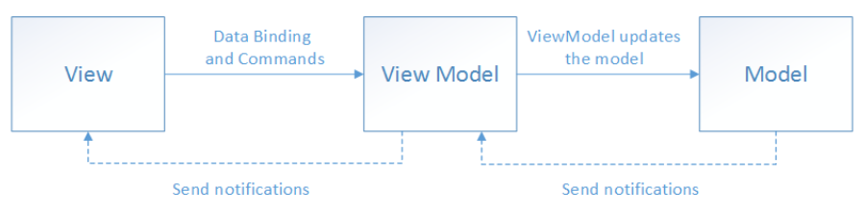
More on MVVM here
https://learn.microsoft.com/en-us/dotnet/architecture/maui/mvvm
Smallest MVVM example:
https://github.com/MarkWithall/worlds-simplest-csharp-wpf-mvvm-example/tree/C%239.0

Slide 28
MVC or MVVM?
https://stackoverflow.com/questions/667781/what-is-the-difference-between-mvc-and-mvvm

Slide 29
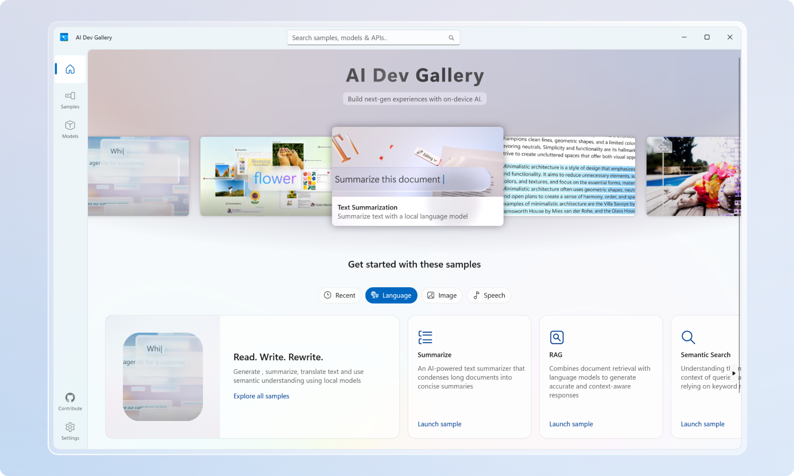
Store > AI Dev Gallery
Source: https://github.com/microsoft/ai-dev-gallery

Slide 30
More samples source code
https://github.com/microsoft/WindowsAppSDK-Samples
https://github.com/scottkuhl/awesome-winui
https://learn.microsoft.com/en-us/windows/apps/design/downloads
Inventory sample: https://github.com/microsoft/InventorySample
.Net POS: https://github.com/livealvi/.NET-Point-of-Sale-POS--Csharp

Slide 31
Best practices
Windows Application Development - Best Practices

Slide 32
User experience
Windows 11 design principles
WinUI 3 Figma Design toolkit
Areas to focus
Layout
UI interaction
Visual style
Window behavior
Shell integration points

Slide 33
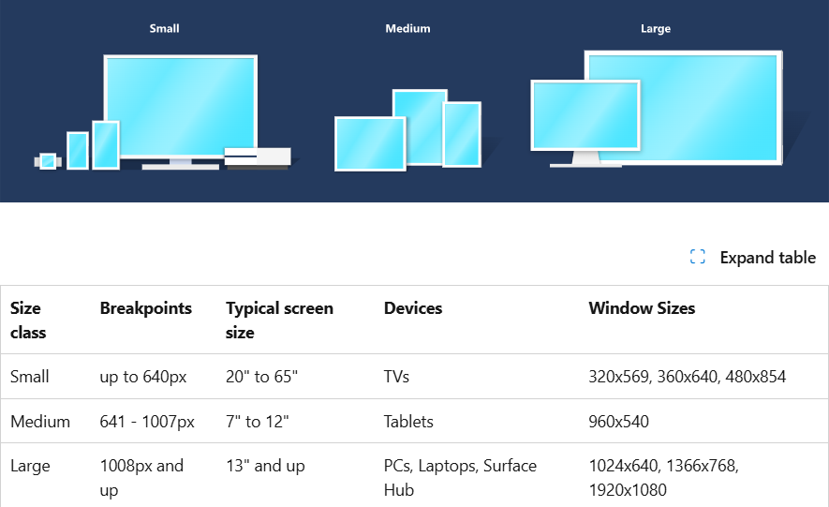
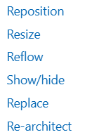
Responsive layout
https://learn.microsoft.com/en-us/windows/apps/design/layout/responsive-design

Slide 34
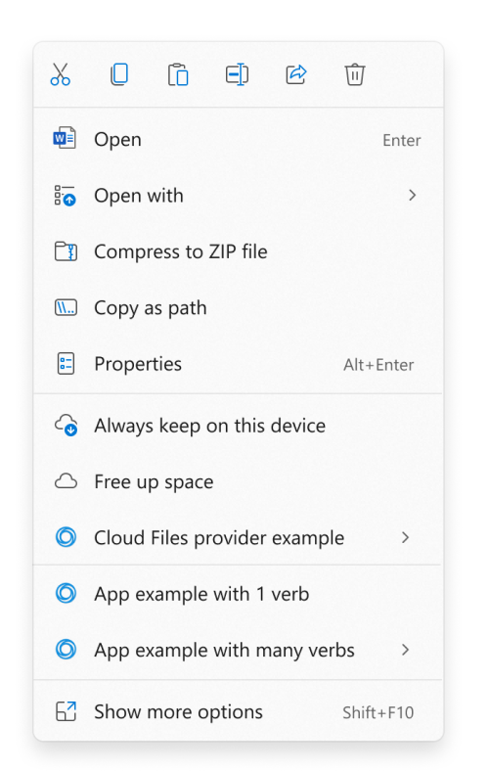
On-object commanding
Context menus
Swipe commands
Keyboard shortcuts.

Slide 35

Materials: Acrylic and Mica
11 things to make your app great

Slide 36
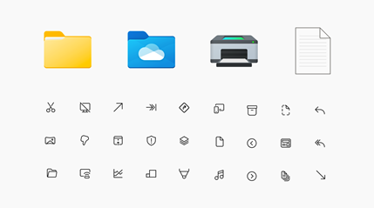
Iconography and typography
New fonts & New icons

Slide 37
Apps to clone as a practice
Store
Settings
Weather
XBox / Spotify / Netflix

Slide 38
App for business references
Cukcuk, KiotViet, Sapo, POS365, Odoo, Nhanh.vn, OXU
DanTriSoft, ShopeeFood, Foody, Grab
Square POS, Toast POS, Lightspeed
Heartland Retail, Suno
PosApp, Clover, KORONA, iPOS.vn

